Slide 1
Google Big Query
ADBMS Project
Group 10
Reddy Prasad Rayalam [U59315263]
Sharvari More [U15211982]
Shyam Rishi Kashyap Sai Kalaparthy [U49692828]
Thulasi Sai Mediga [U86877256]

Slide 2
Agenda
Team Introduction
A Brief Description of Google Big Query
Big Query Organization
Features of Big Query
Advantages of Big Query
Disadvantages of Big Query
Dataset used
ETL Process
Business Opportunities

Slide 3
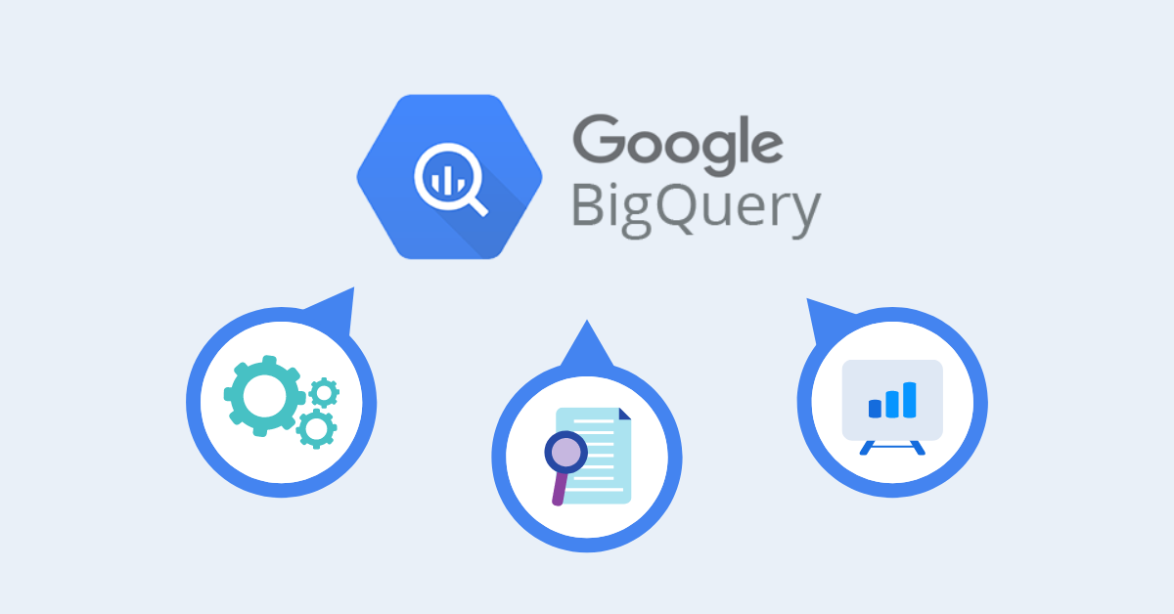
Google Big Query
Fully managed analytical databases.
Developed by Google in 2010.
Columnar data storage enhances focus on data.
Virtually unlimited storage capacity.
Pay-as-you-go pricing for cost-effectiveness.

Slide 4
Serverless Data Warehousing: As a serverless data warehousing solution, Google Big Query eliminates the need for infrastructure management and reduces operational overhead. This allows data professionals to focus on analysis and insights rather than system administration.
Seamless Integration: Google Big Query seamlessly integrates with various Google Cloud services, such as Google Cloud Storage, Cloud Dataflow, Cloud Pub/Sub, and more. This enables users to build end-to-end data pipelines and leverage the full power of the Google Cloud ecosystem.
AI and Machine Learning: Big Query is equipped with machine learning capabilities, allowing users to build and deploy machine learning models on their data. It simplifies the process of predictive analytics and AI-driven insights.
Data Governance: Google Big Query offers robust data governance features, including fine-grained access controls, data classification, and data lineage tracking. This ensures that sensitive data is protected and compliant with industry regulations.

Slide 5
Google Big Query Organization
Big Query is structured as a hierarchy with 4 Levels as follows:
Projects: Top–level containers in the Google Cloud platform that store the data.
Datasets: Within projects, datasets hold one or more tables of data.
Tables: Within datasets, tables are row-column structures that hold actual data.
Jobs: Tasks performed on the data like running queries, loading and exporting data.

Slide 6
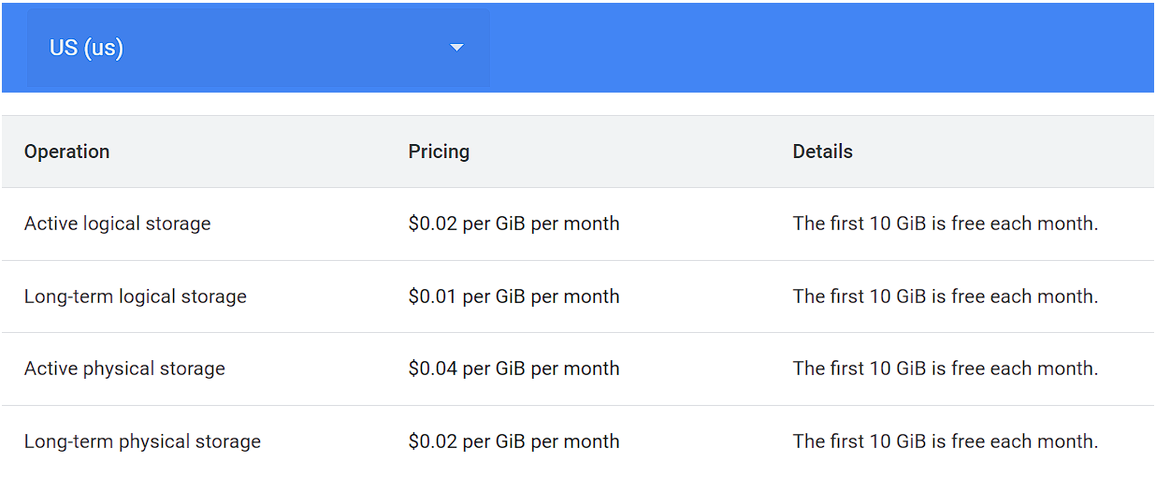
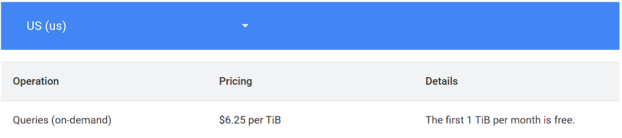
Features of Google Big Query
Pricing for storage
Highly scalable and reliable.
Handles complex analytical data.
Serverless Distributed SQL Engine that supports DDL and DML commands.
Runs petabyte queries in seconds.

Slide 7
Advantages of Google Big Query
Big Query offers a flexible and cost-effective pricing model.
Big Query has an active user community and web interface, accessible to both technical and non-technical users.
Provides robust security features, including encryption, IAM, and auditing capabilities.
Supports real-time data analysis through integration.

Slide 8
Disadvantages of Google Big Query
Big Query does not enforce keys, foreign keys, or constraints.
Single-line inserts are discouraged.
Big Query does not perform well with the normalized schema as it encourages denormalization.
Needs to be used with other structured databases to handle the ETL process effectively.

Slide 9
Describe the dataset
We have used two datasets as Sales and Customer for our database:
1. Sales:
The sales_data.csv contains transactional records for sales, including details such as an invoice number, customer identifier, product category, quantity of items purchased, price, the date of the transaction, and the shopping mall where the purchase was made.
This data is crucial for tracking sales performance, inventory management, and customer purchasing behavior.
2. Customer:
The customer_data.csv holds demographic information and payment method details for customers, including the customer identifier, gender, age, and payment method.
This data is useful for customer segmentation, marketing strategies, and analyzing sales trends with demographic factors.

Slide 10
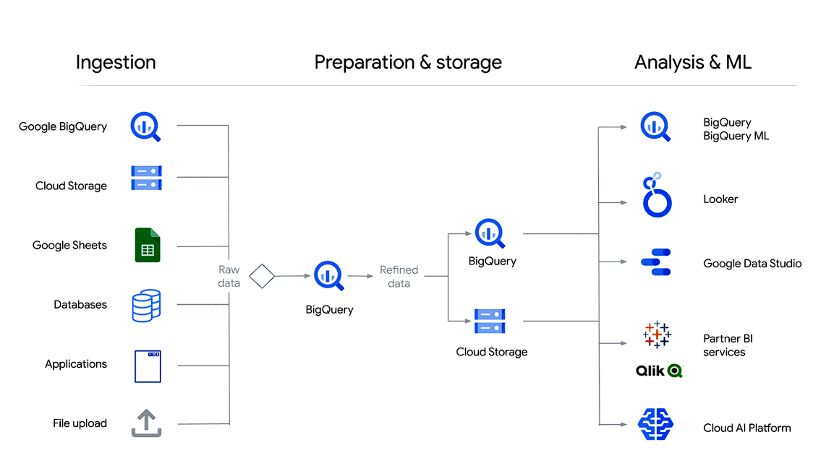
ETL Process in Google Big Query
Data is sourced from diverse locations.
Transformation involves cleaning, structuring, and enriching data.
Transformed data seamlessly loads into Big Query.
Automation and scalability streamline ETL workflows.
Data security and integration are integral to the process.

Slide 11
Leveraging Google Big Query for Data-Driven Excellence
Data Analysis: Businesses leverage Google Big Query for in-depth data analysis. They run complex queries to gain insights, identify trends, and make data-driven decisions.
Real-Time Analytics: Real-time data streams are analyzed in Big Query for immediate insights, enabling businesses to react swiftly to changing conditions.
Data Warehousing: Big Query serves as a data warehouse, storing vast amounts of structured and semi-structured data, and optimizing query performance.
Cost Efficiency: Its serverless architecture and pay-as-you-go pricing make it cost-effective, as companies only pay for the data they process.
Machine Learning: Big Query's machine learning capabilities allow businesses to develop and deploy predictive models, enhancing their products and services.

Slide 12
Data Visualization: Integration with data visualization tools enables the creation of interactive dashboards and reports for clear data presentation.
Security and Compliance: Robust security features ensure data protection and compliance with industry regulations.
Scalability: Big Query scales effortlessly to handle growing datasets, making it adaptable for businesses of all sizes.
Data Monetization: Some businesses monetize their data by sharing it on the Google Cloud Marketplace, creating new revenue streams.
Streamlining Operations: By automating ETL workflows with Google Big Query, businesses streamline their data processes and save time.
Competitive Advantage: Ultimately, Google Big Query empowers businesses with a competitive edge through data-driven decision-making and efficient data management.

Slide 13
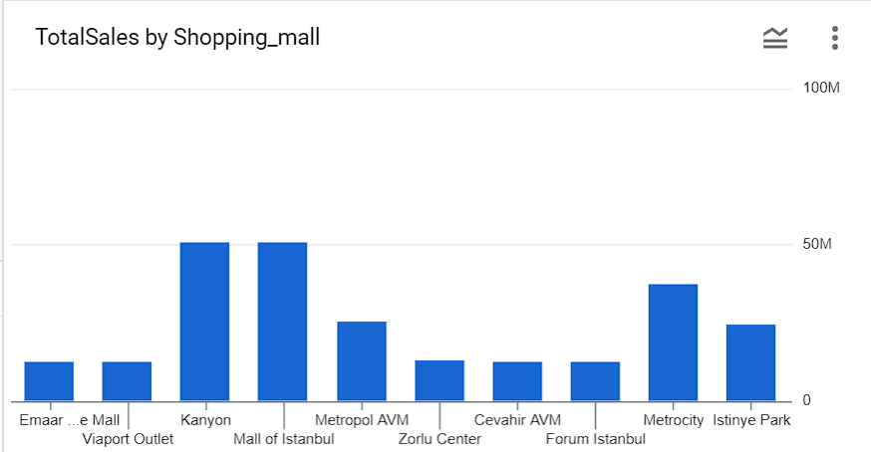
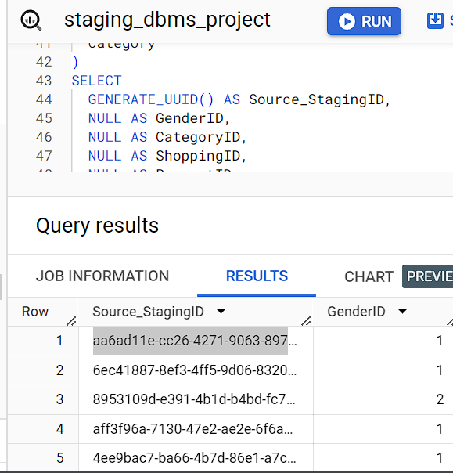
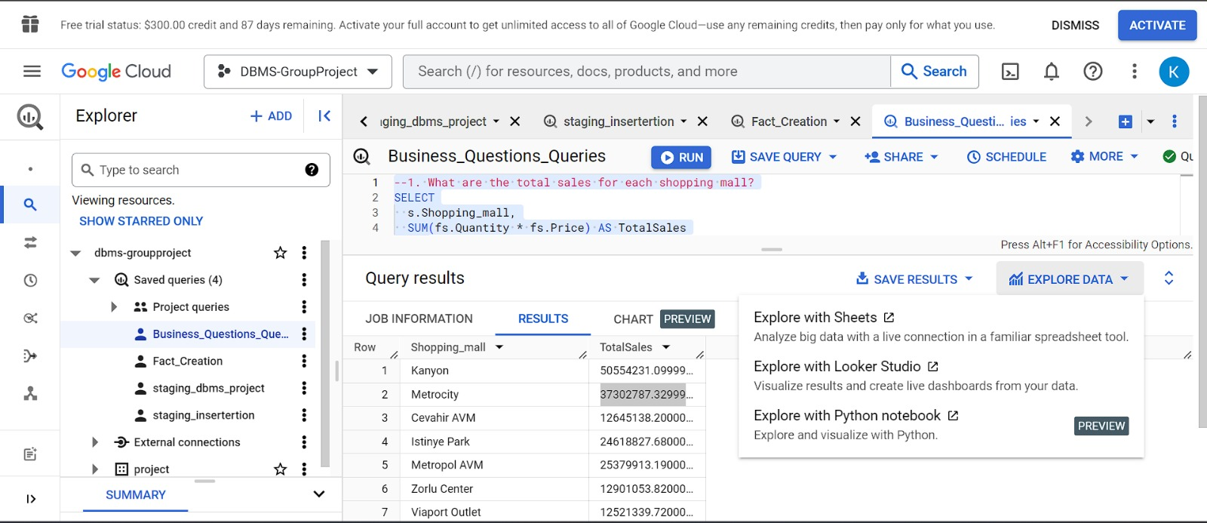
We have derived a business question to calculate the total sales of each shopping mall from the dataset in Big Query

Slide 14
Teams Recording Link
https://usfedu-my.sharepoint.com/:v:/r/personal/thulasisaimediga_usf_edu/Documents/Recordings/Call%20with%20Reddy%20and%202%20others-20231108_215557-Meeting%20Recording.mp4?csf=1&web=1&e=1VQ6HA&nav=eyJyZWZlcnJhbEluZm8iOnsicmVmZXJyYWxBcHAiOiJTdHJlYW1XZWJBcHAiLCJyZWZlcnJhbFZpZXciOiJTaGFyZURpYWxvZyIsInJlZmVycmFsQXBwUGxhdGZvcm0iOiJXZWIiLCJyZWZlcnJhbE1vZGUiOiJ2aWV3In19

Slide 15


Thank You!

